Slide 1
Agenda for GEOG260/360 GIS & Land Change Models
Today
Introductions, logistics, examples, and aspirations
Discuss reasons for this course and why we simulate land change
Before Next Class
Gain access to TerrSet
See the various forms of colorblindness at http://www.colourblindawareness.org/
Read story at https://clarknow.clarku.edu/2020/08/20/clark-labs-forecasts-how-land-use-will-change-across-the-globe-by-2050/
Watch Learn why to use Misses, Hits, and False Alarms to indicate diagnostic ability at https://www2.clarku.edu/faculty/rpontius/videos.html
Watch video at https://help.newenglandlandscapes.org
See https://www.youtube.com/watch?v=6p8zAbFKpW0 and https://www.greenbiz.com/article/are-carbon-offsets-joke-response-comedian-john-oliver
August 30
Philosophy of Modeling
Receive instructions for Assignment 1
See https://www.theguardian.com/environment/2023/jan/18/revealed-forest-carbon-offsets-biggest-provider-worthless-verra-aoe
and a response at https://www.sylvera.com/blog/guardian-offsets-response
September 4
No Class
September 6 Deadline for Add/Drop
Discuss Assignment 1
September 11
Introduction to Geomod
September 13
Geomod land change allocation model in TerrSet
Assignment 1 is due at 4pm via Moodle
September 15 Deadline to declare Pass/Fail Grade

Slide 2
Introductions
Professor Robert Gilmore Pontius Jr, known in the USA as Gil and in Brazil as Pontius rpontius@clarku.edu
Teaching Assistant Sushil Paudel spaudel@clarku.edu
Peer Learning Assistant Tanner Honnef thonnef@clarku.edu
See the syllabus for office hours via zoom and in-person in the Academic Commons, which have TerrSet-enabled computers near the Help Desk
Post all questions that might be relevant for other students to the Have Discussions section at the top of our Canvas site.
As of 27 August, you are 3 Sophomores, 1 Junior, 7 Seniors, 5 Masters students. Majors include Undeclared, Environmental Science & Policy, Geographic Information Science, Geography, Global Environmental Studies, and Political Science.
If you use a name other than what is on your CLARKU account, then send that name to the professor and assistants. Students are invited to send also their preferred pronouns.

Slide 3
Sushil Paudel
Sushil Paudel holds a Master of Science in Forestry from Agriculture and Forestry University, Hetauda, Nepal, and a Master of Science in Geographic Information Science and Systems from Salzburg University, Austria. He has been a Forest and GIS Officer at Expert Group Pvt. Ltd, Nepal, and a part-time GIS and Data Science instructor at Broadway Infosys Pvt. Ltd., Subidhanagar, Nepal. He has been involved in several Forest and Environmental assessment projects where he acquired field data and prepared Forest and Environment Management Plans for government agencies. His major interest is developing practicable forest resource inventory and analysis methodology using UAVs and deep-learning models for forest carbon assessment. Sushil has TerrSet working on his Mac laptop.

Slide 4
Tanner Honnef
Tanner Honnef is a senior Geography major from California. He earned an A in this course during Fall 2021. He is now in the second semester of his Honors Thesis working with Professor Pontius on the topics of this course as they relate to forestry-based carbon offset projects in coordination with the researcher at Clark Labs. Tanner recently did a semester abroad in Chile. Tanner plans to earn his Masters in GIS next year as part of Clark’s Advanced Degree Program. Tanner is captain of the Clark tennis team, and will string your racket as part of the business he created.

Slide 5
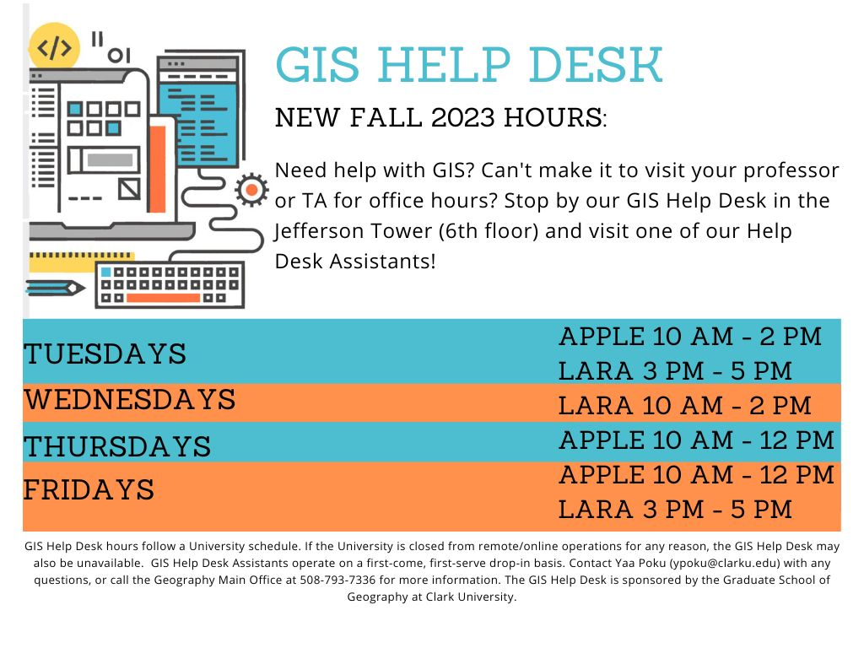


Lara Jordan and Apple Gould-Schultz are 5th year Masters GIS students and this semester’s assistants at the GIS Help Desk. Lara Jordan took this course in fall 2020.
Lara Jordan Apple Gould-Shultz
Founder of SQUIDINK

Slide 6
Attendance and Random calling
Attendance
You must attend every class on time and in person. Classes are neither recorded nor offered online.
If you cannot attend, then you must send a message to the assistants and the professor before the class to explain your absence.
Random calling
The professor will call on students according to a randomized list because the professor wants:
To learn your names
To understand what you are thinking
To regulate the speed at which the professor covers material
To assure the professor treats all students equally
To keep you on your toes
To put you on the spot so you get used to it before other people put you on the spot
To give you the opportunity
to answer,
to ask for clarification,
to guess, but then the professor is likely to ask you why,
to decline to answer thus to pass to the next person on the list,
to call on another student for a lifeline, or
to inform the professor that you are lost.

Slide 7
Colorblindness
Approximately 4% of people have some form of color blindness. The percentage varies depending on depending on ancestry and gender, with males having rates 16 times higher than females. If you are such a person, then please inform the instructor and the assistants, who will then strive to clarify the important colors in the maps during class. See http://www.colourblindawareness.org/
You must consider this when you select the color palettes for your maps.
There is more than 50% probability that at least one person is color blind in an audience of more than 17 people.

Slide 8
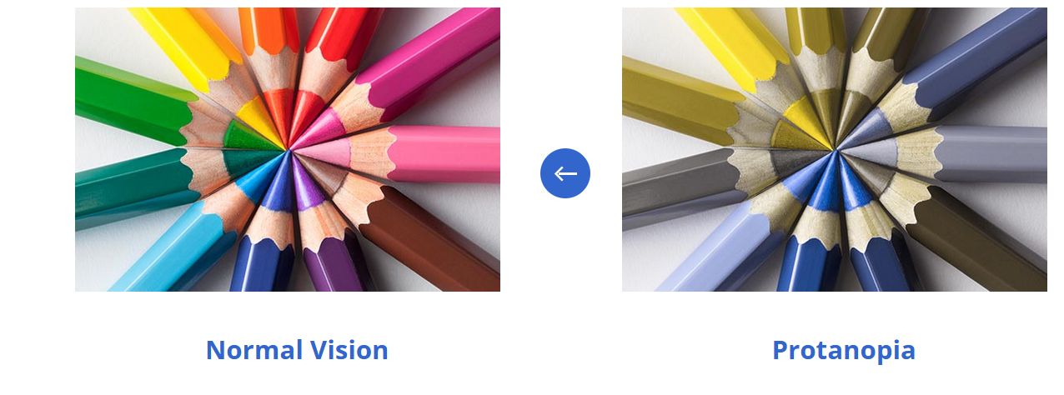
The most common difficulty is to distinguish red from green

Slide 9
Prerequisites
Official Prerequisite is Intro to GIS, listed as GEOG190 or IDCE310.
Practical prerequisite is high school level mathematics and basic knowledge of TerrSet. Familiarity with raster GIS is essential.
If you do not have the official prerequisite, then you might still be sufficiently prepared to do well in this course. If you take GEOG190 or IDCE310 concurrently, then you will likely be able to follow this course. If you have not taken GEOG190 or IDCE310 at Clark University, then you need electronic permission from the professor to register. To get permission, send an email message to the professor at rpontius@clarku.edu, which will prompt Professor Robert Pontius to give you permission to enroll at your own risk.

Slide 10
Software
We will use Excel, TerrSet GIS software, and perhaps free software such as R. TerrSet is available in Clark University labs, such as the Academic Commons in Goddard Library. Ownership of your own computer is not required for this course, but if you have your own computer then the professor recommends you use it. TerrSet is designed to work on PCs. TerrSet can work on Macs depending on how the Mac is set up. If you need help with your Mac, then ask our Teaching Assistant Sushil Paudel.
Clark Labs Support Center answers technical questions concerning TerrSet via https://forums.clarklabs.org/hc/en-us
For instructions on how to access TerrSet online via Clark University resources, see https://www.clarku.edu/offices/its/a-z-service-catalog/vlabs/ Vlabs looks like a normal desktop environment, but any files saved to the TerrSet environment will be deleted when you exit Vlabs.

Slide 11
Your status as a Clark student entitles you to a one-year TerrSet Student Starter license at no cost
It may take up to 48 hours to complete your order.
If you had a student starter license that has expired, then you can buy a one-year student starter license for $49 or a permanent student license for $99. Price is higher for non-students.
If anyone wants a free license for this semester, then raise your hand, which will prompt Pontius to send the list of students to Clark Labs.

Slide 12
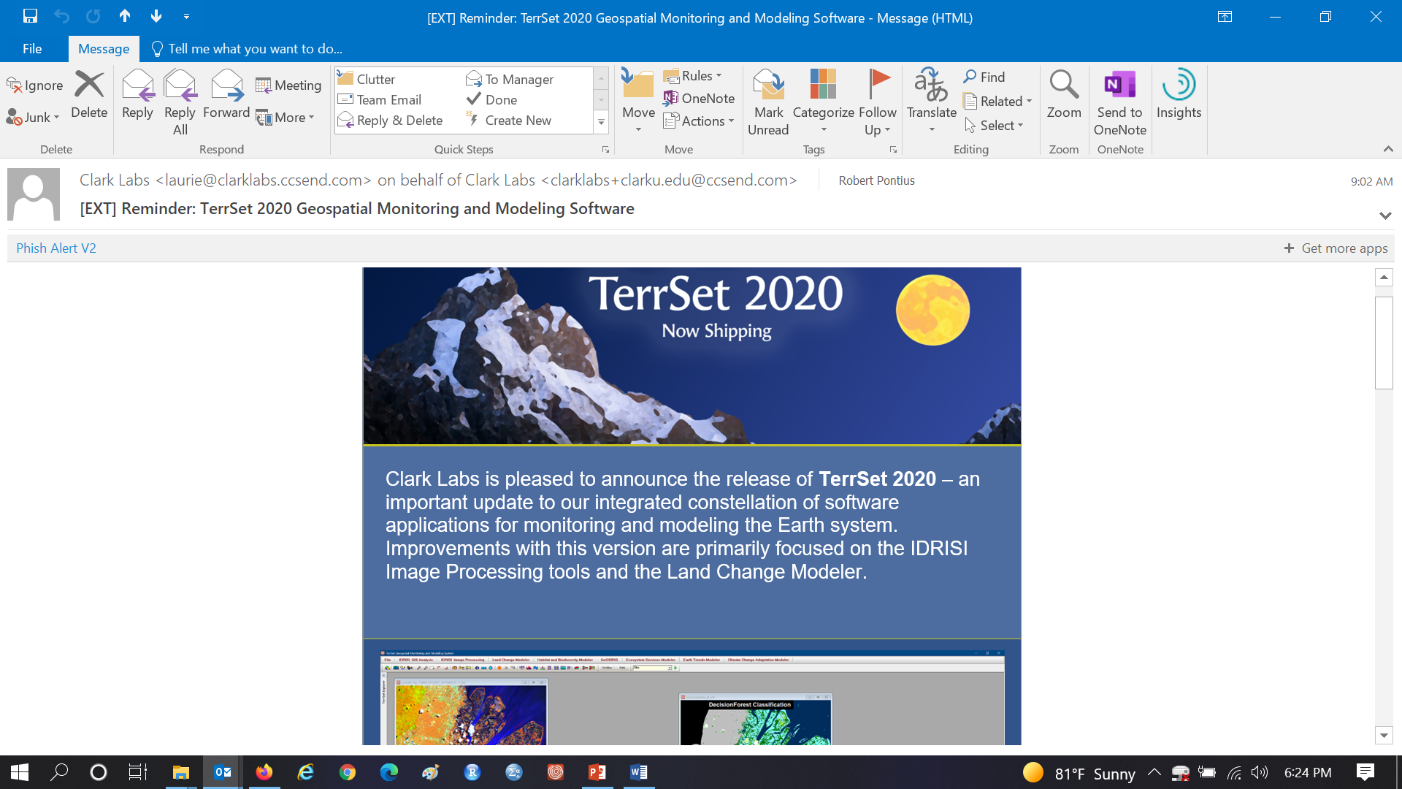
TerrSet 2020

Slide 13
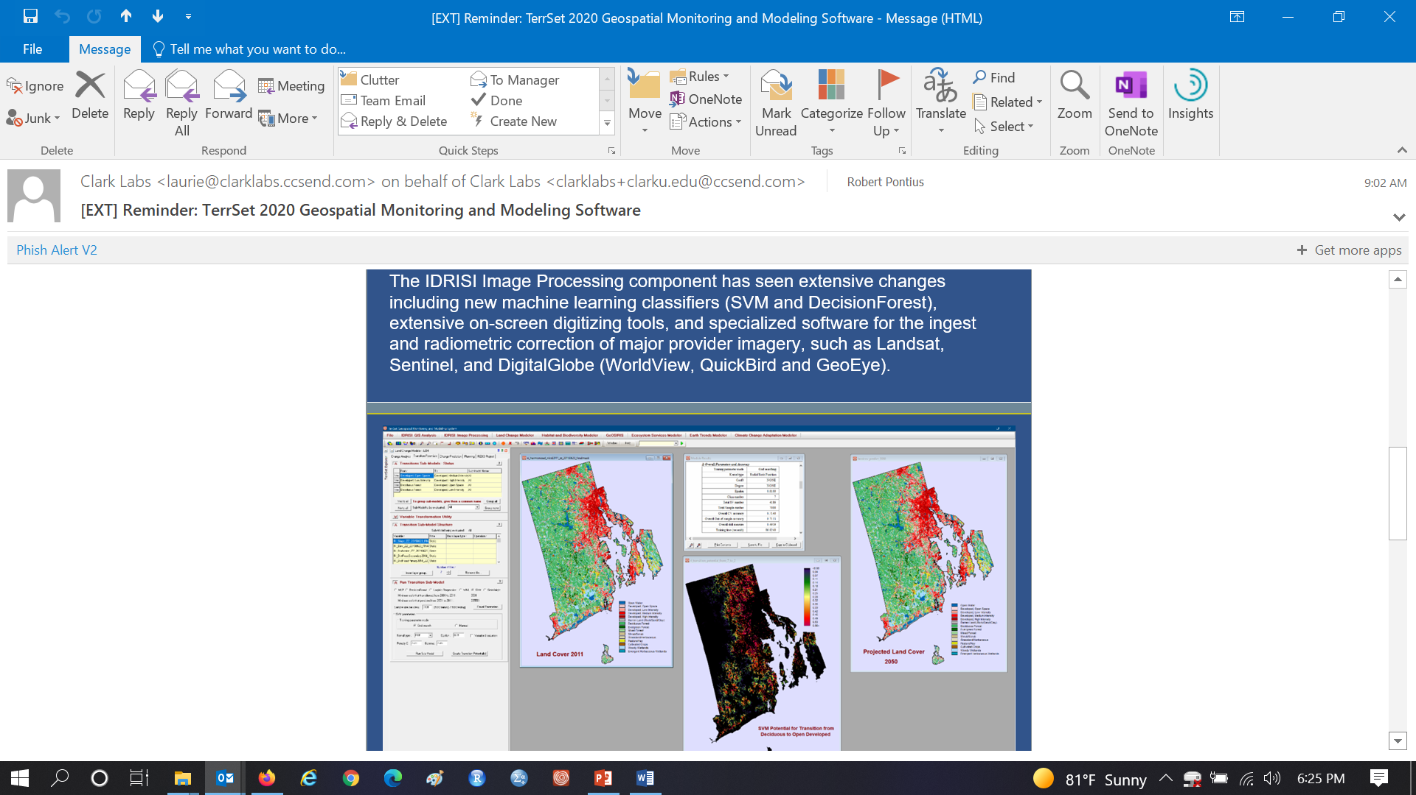
TerrSet 2020

Slide 14
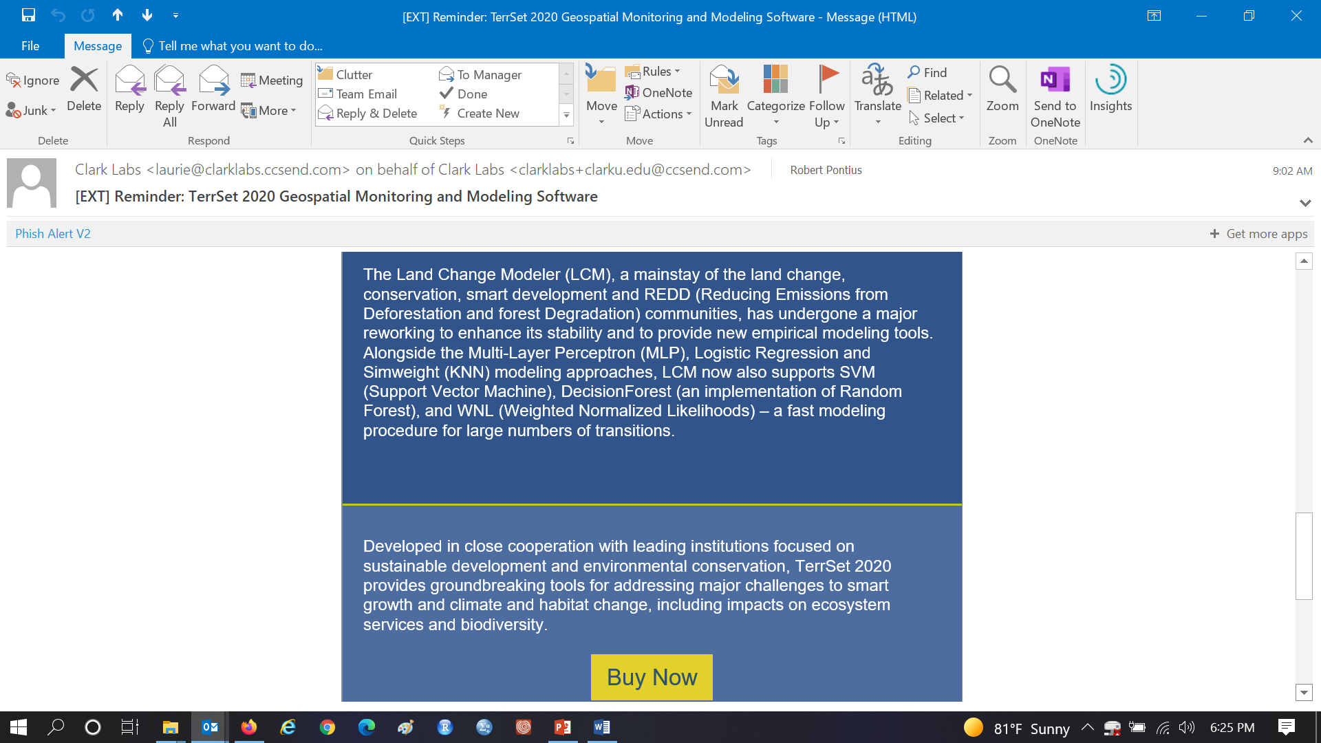
TerrSet 2020

Slide 15
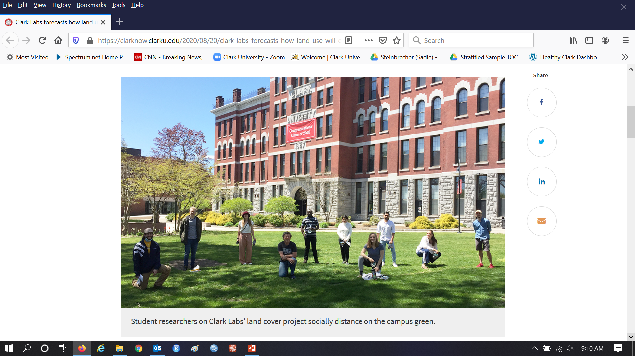
Clark Labs forecasts how land use will change across the globe by 2050 https://clarknow.clarku.edu/2020/08/20/clark-labs-forecasts-how-land-use-will-change-across-the-globe-by-2050/

Slide 16
Grading
Scale
The grading scale follows Clark University’s definitions, where the maximum grade is A defined as 95%. If a submitted assignment is completely correct, then the grade is A meaning 95%. If an assignment contains insights beyond the instructions, then the assignment can earn up to 100%.
Assignments
The professor gives instructions for each assignment usually on Wednesdays
You should try the assignment on your own, then consult with classmates then ask the assistants.
Come to class on Mondays with questions.
Assignments are due Wednesdays at 4pm.
If you work on an assignment with classmates to the point that you and your classmates develop one response, then submit that one response to Canvas with all of the group member names. All members will get the same grade.
Each assignment has an equal weight concerning its influence on the semester’s grade.
Exam
This is the only part of the course that you do individually.
The exam counts six times the value of each assignment concerning the influence on your final grade.
Project
You will work in teams of a few students. Get to know your classmates in person now.
Proposal and PPTX of your presentation each count as much as an assignment concerning your final grade.
The Product counts three times the value of each assignment concerning the influence on your final grade.

Slide 17
Accomplishments of previous students
Paid summer research experiences
Jess Strzempko, Thomas Bilintoh, Sadie Murray, Ethan Manley, Zainab Farid
Theses
Sadie Murray, Emily Evenden, Thomas Bilintoh
Science conferences
Thomas Bilintoh, Emily Evenden, Smruti Naik, Rachel Corcoran-Adams, Elizabeth Lohr, Jess Strzempko, Ruthanne Ward
Publications
Emily Evenden https://www.mdpi.com/2220-9964/10/10/686
Jess Strzempko https://www.mdpi.com/2073-445X/12/7/1471
Videos
Paige Taylor, Hannah Safer, and Jessica Martinez concerning Misses, Hits, Wrong Hits, False Alarms and Correct Rejections at https://www2.clarku.edu/faculty/rpontius/videos.html
Wikipedia
https://en.wikipedia.org/wiki/GeoMod
Professions
Smruti Naik with https://www.nisc.coop/
Sarah Philbrick with Boston Metro Area Planning Council
Max Wright with Conservation International

Slide 18
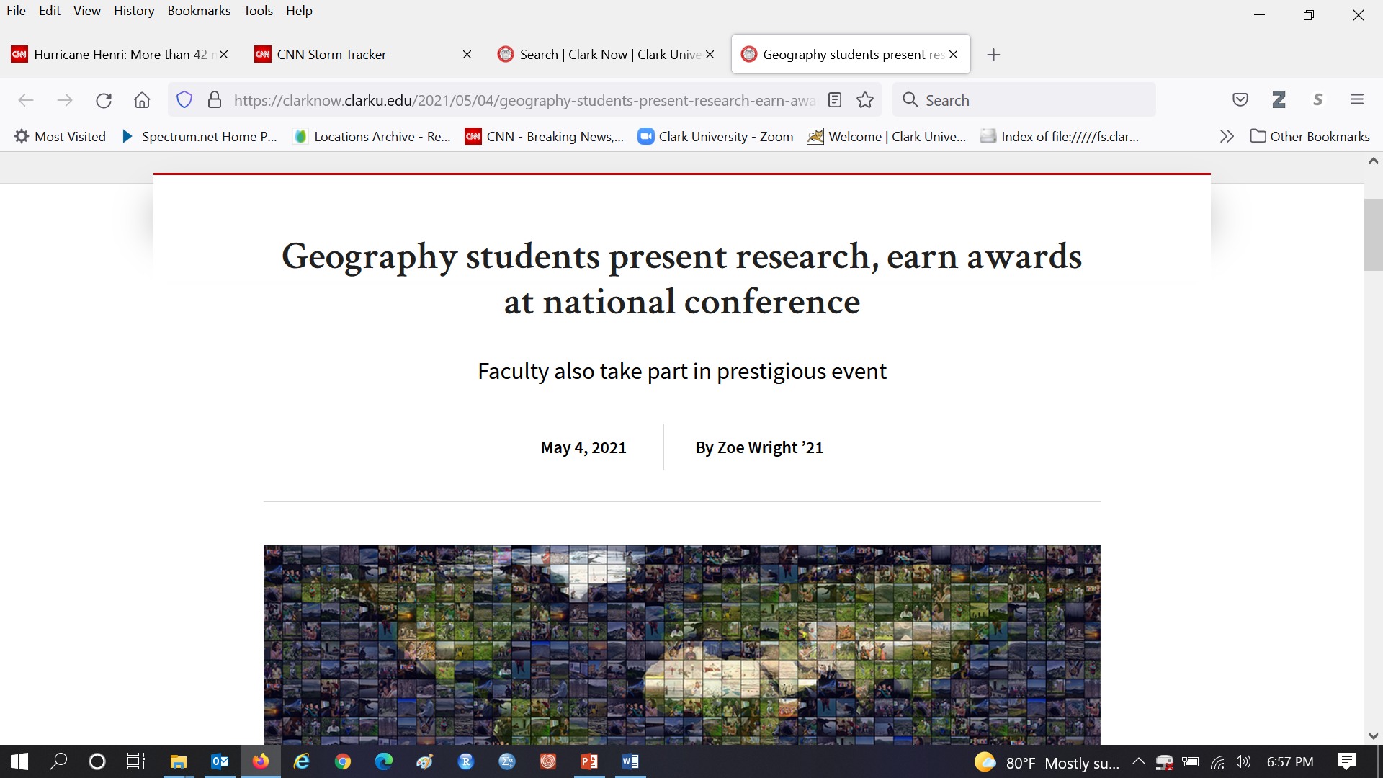
https://clarknow.clarku.edu/2021/05/04/geography-students-present-research-earn-awards-at-national-conference/

Slide 19
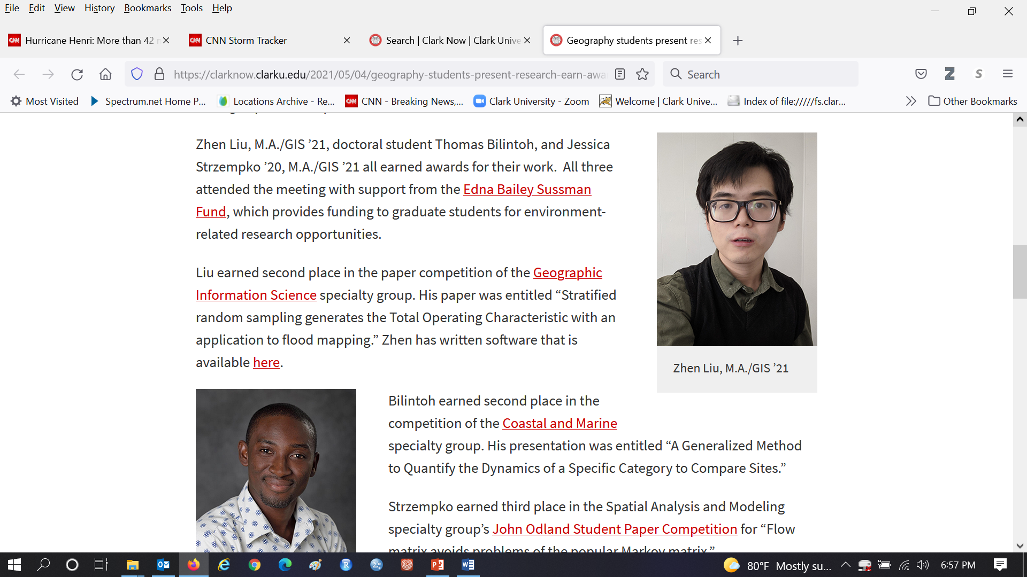
https://clarknow.clarku.edu/2021/05/04/geography-students-present-research-earn-awards-at-national-conference/

Slide 20
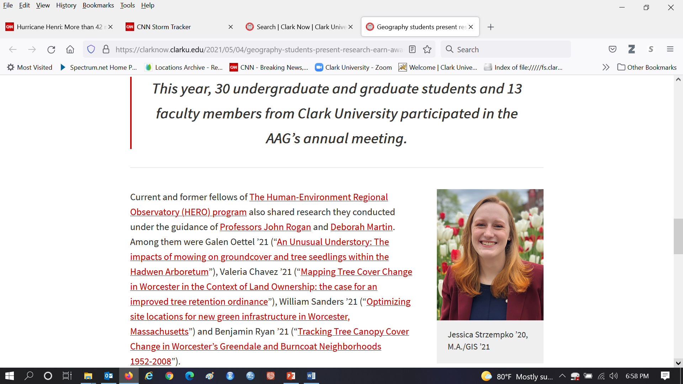
https://clarknow.clarku.edu/2021/05/04/geography-students-present-research-earn-awards-at-national-conference/

Slide 21
Use this course to win an award in a competition at the meeting of the American Association of Geographers www.aag.org Abstracts are due November 16. Abstracts for other posters are usually accepted till January. AAG meeting is 16-20 April 2024 in Hawaii.

Slide 22
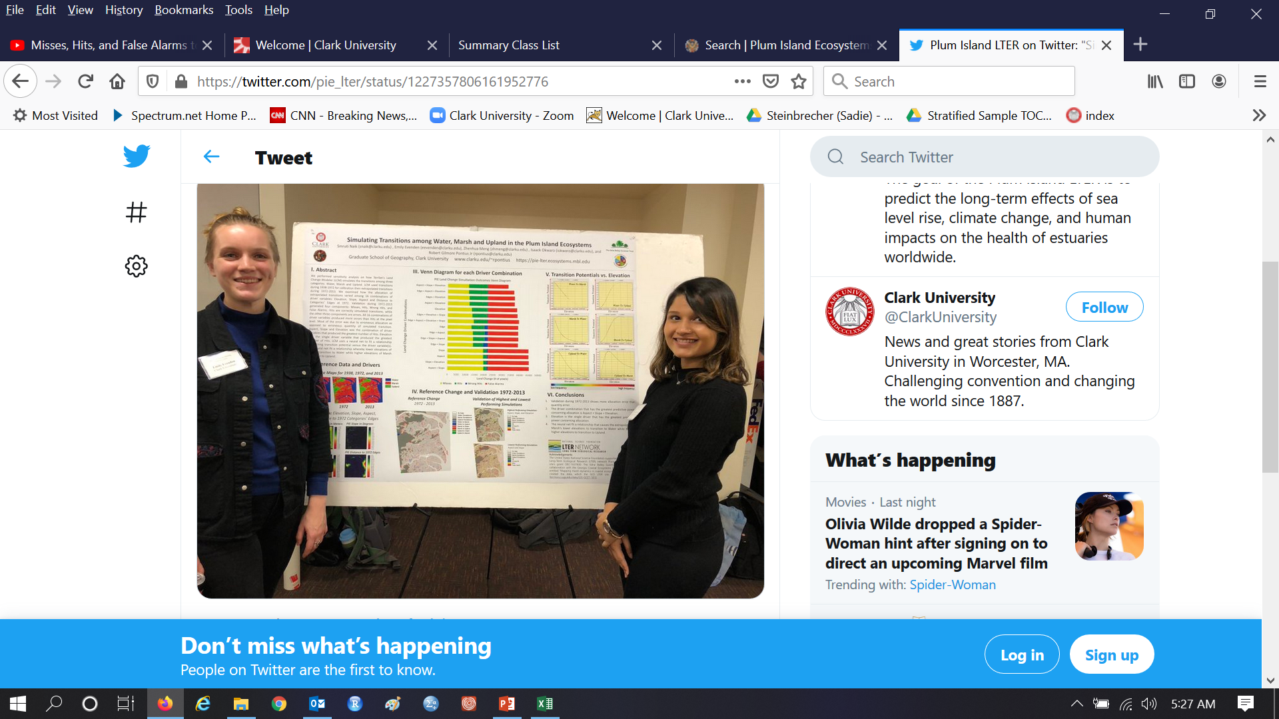
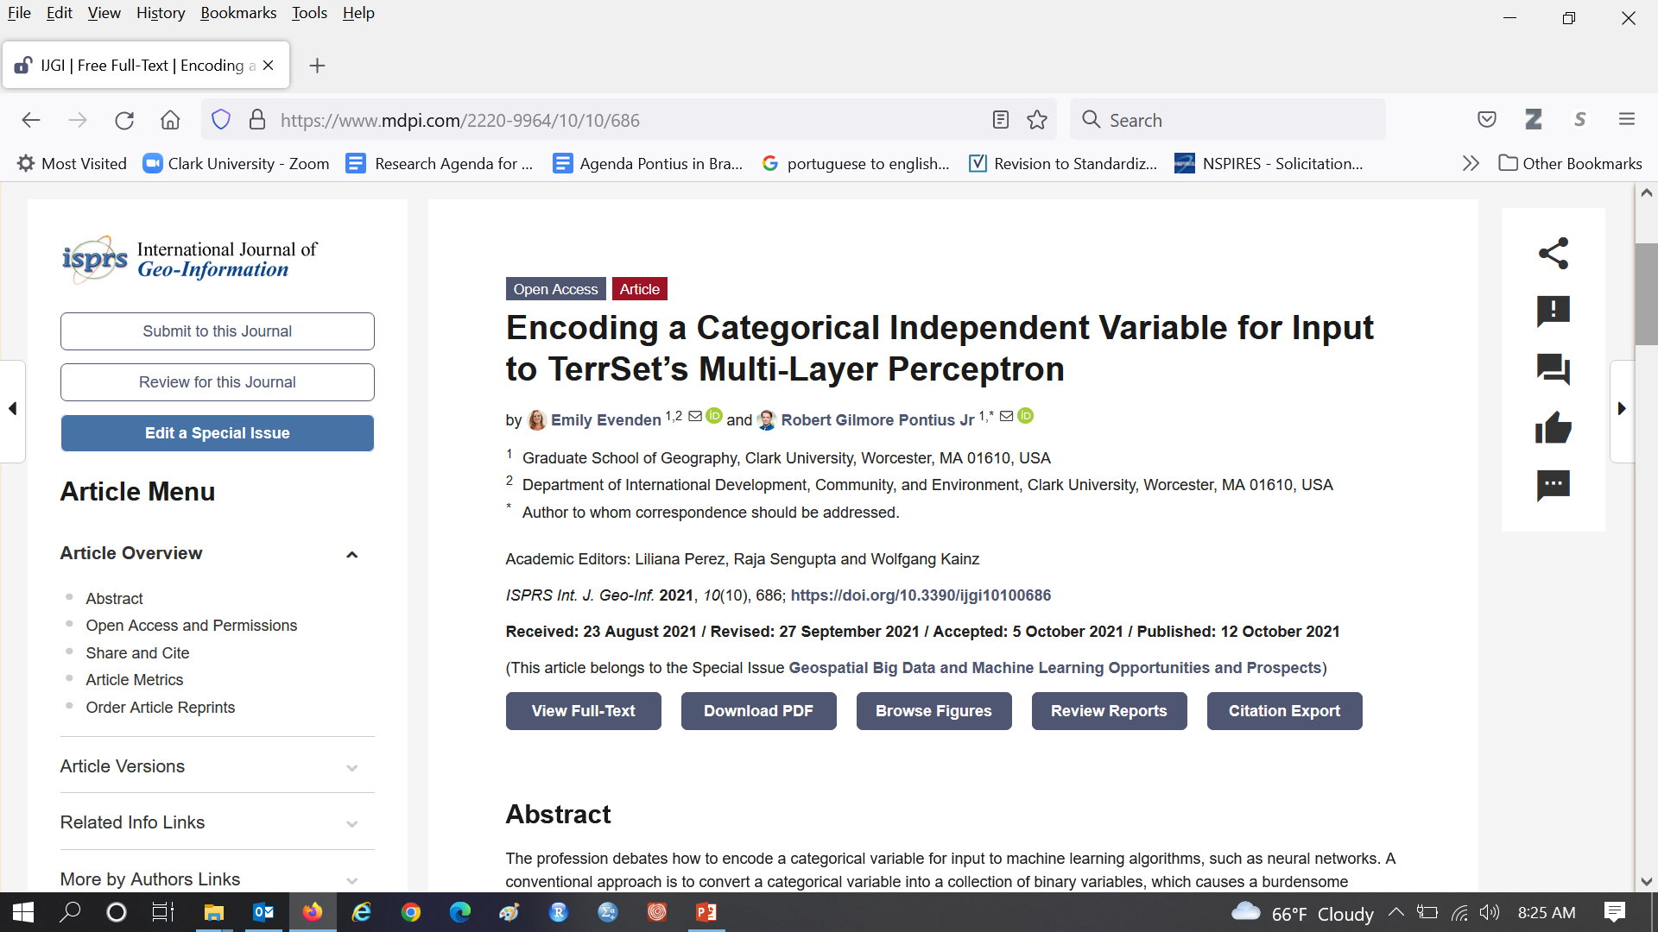
Emily Evenden and Robert Pontius published a journal article at https://www.mdpi.com/2220-9964/10/10/686

Slide 23
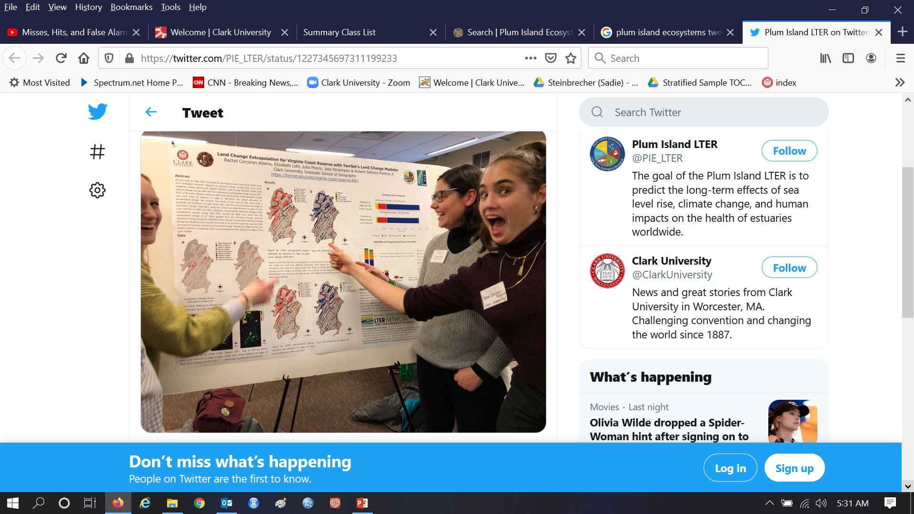
Jessica Strzempko and Robert Pontius published a journal article at https://www.mdpi.com/2073-445X/12/7/1471

Slide 24
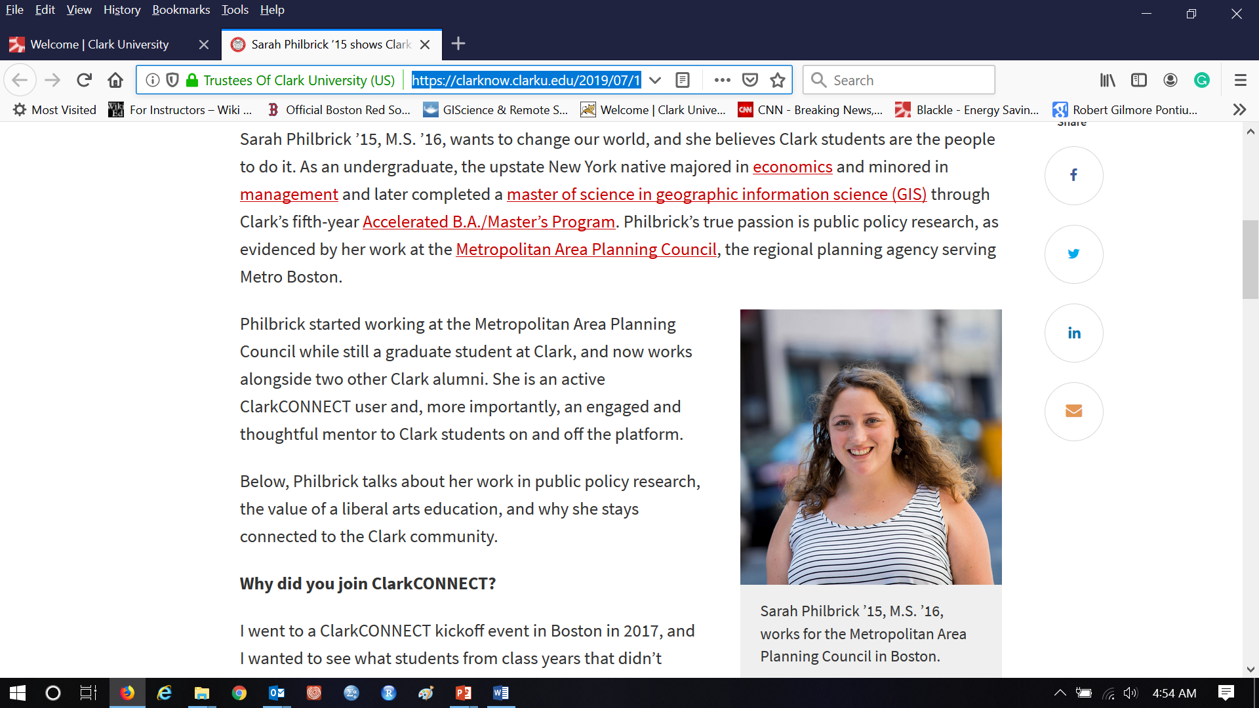
Sarah Philbrick works for Boston Metro Area Planning Council
https://clarknow.clarku.edu/2019/07/11/sarah-philbrick-15-shows-clark-students-the-world-of-public-policy-research/

Slide 25
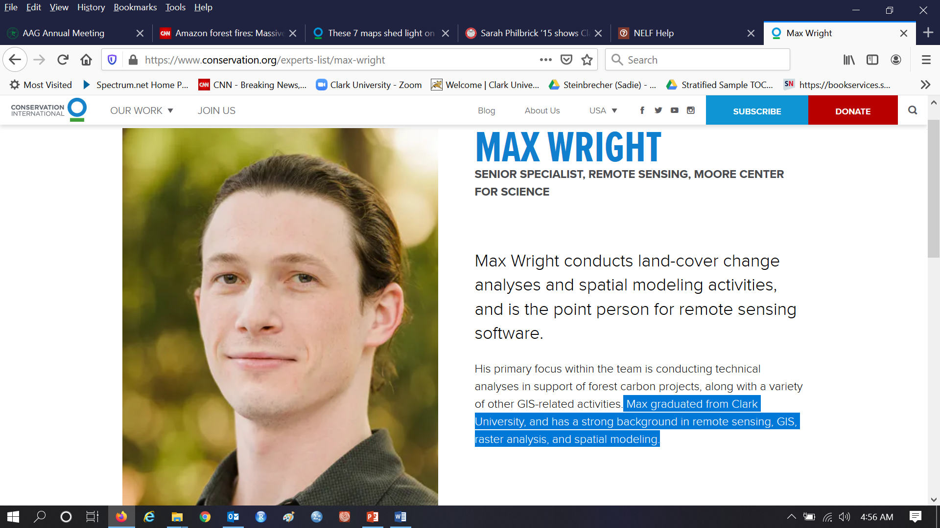
Max Wright works for Conservation International https://www.conservation.org/experts-list/max-wright
https://www.conservation.org/blog/these-7-maps-shed-light-on-most-crucial-areas-of-amazon-rainforest

Slide 26
Join GIS jobs list
To subscribe, send a message to sympa@lists.clarku.edu with "Subscribe gisjobs" in the subject line and nothing in the text.
To unsubscribe, send a message to sympa@lists.clarku.edu with "Unsubscribe gisjobs" in the subject line and nothing in the text
Pontius forwards announcements when he receives them, which are about once per week.

Slide 27
Course Description
This course examines computerized models that simulate land change. Such models are important because land change influences socioeconomic development, biodiversity conservation, water resources, energy use, greenhouse gasses, and many other factors. Applications include suburbanization in Massachusetts and deforestation in projects to Reduce Emissions due to Deforestation and Degradation. Students use TerrSet’s Land Change Modeler and Geomod to learn concepts such as calibration, validation, extrapolation, and sensitivity. The course carries the attribute for Problems of Practice. The prerequisite is Intro to GIS, listed as GEOG190 or IDCE310.

Slide 28
Essential Question and Objectives
How should we use Geographic Information Science to simulate land change?
Students will develop the skills:
To apply concepts and calculations of models that simulate land change for professional-level science.
To explain why various approaches are appropriate or not to address specific research questions.
To produce and interpret output from simulation models using raster GIS software.

Slide 29

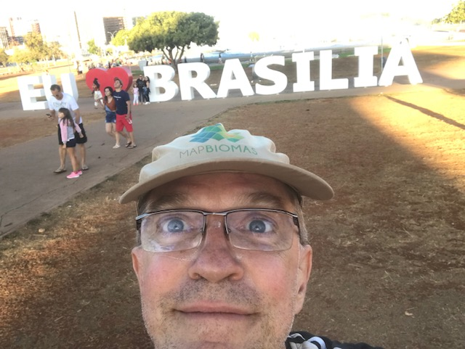
I Brazil’s capital.

Slide 30

Annual Deforestation Rate in the Brazilian Amazon
-84%
190%
Fonte: Imazon
Source: PRODES, INPE

Slide 31
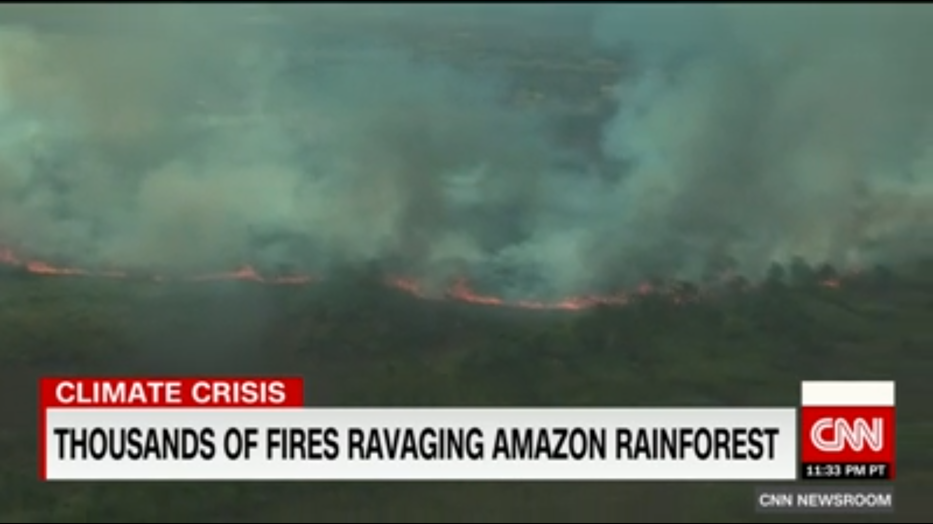
News from the Amazon in 2019.

Slide 32
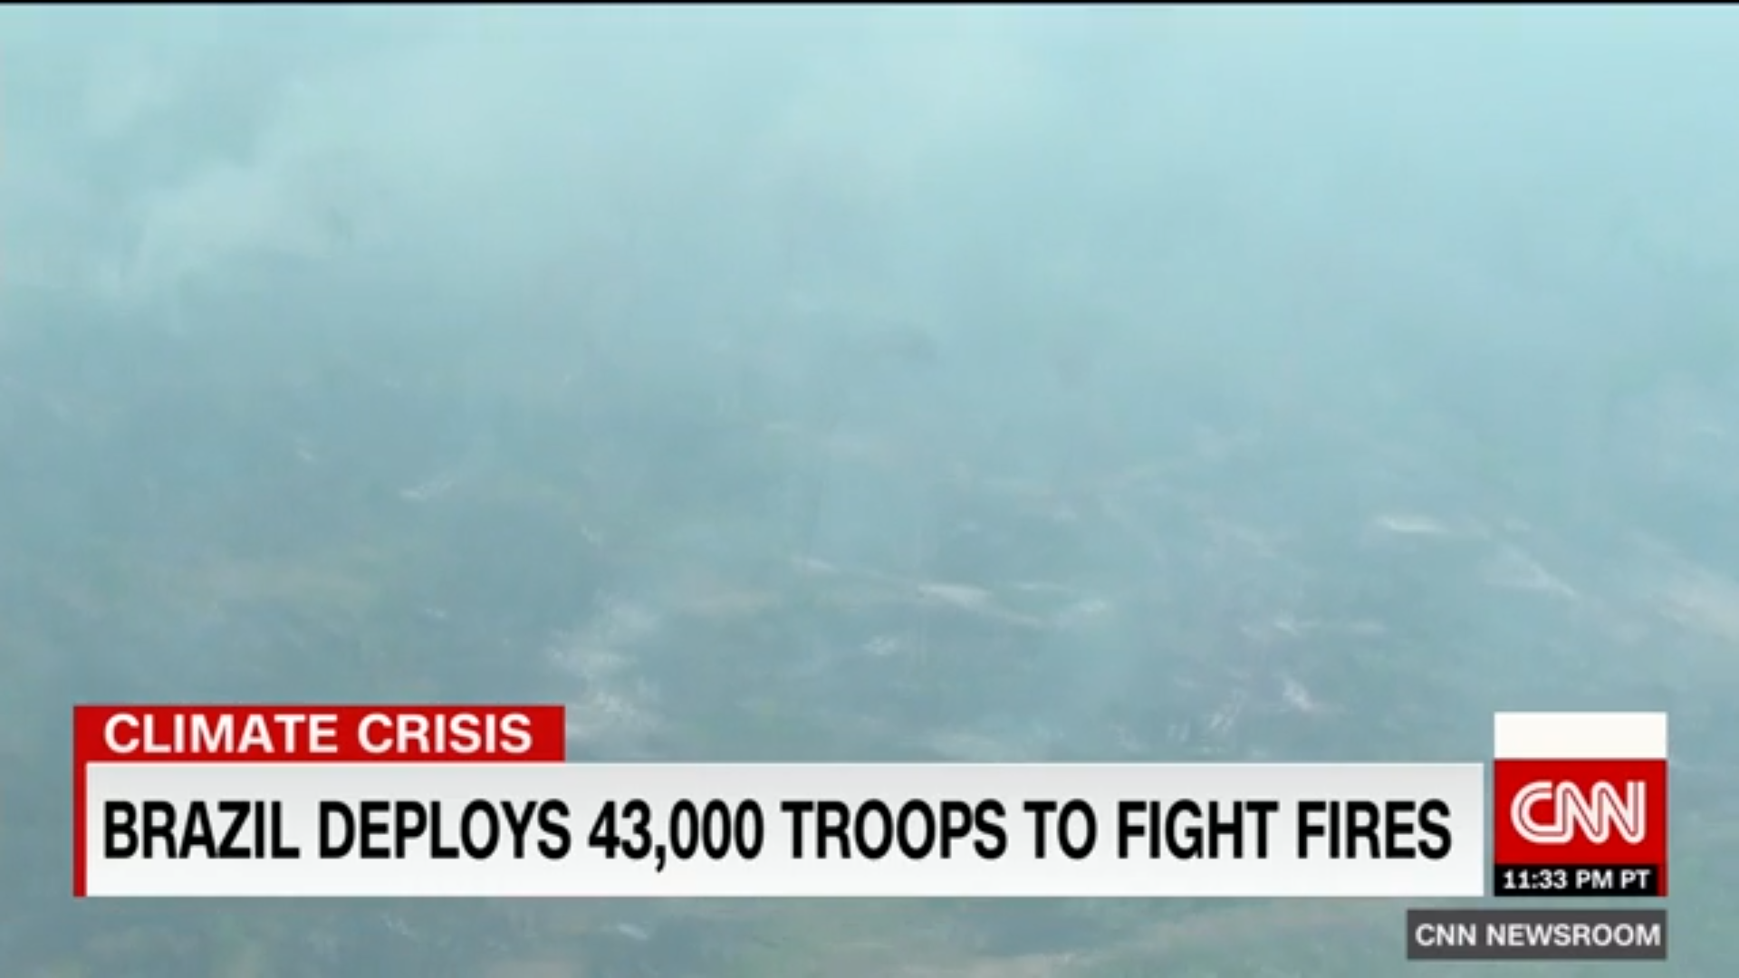
https://www.cnn.com/2019/08/25/americas/amazon-fire-efforts-damage/index.html

Slide 33
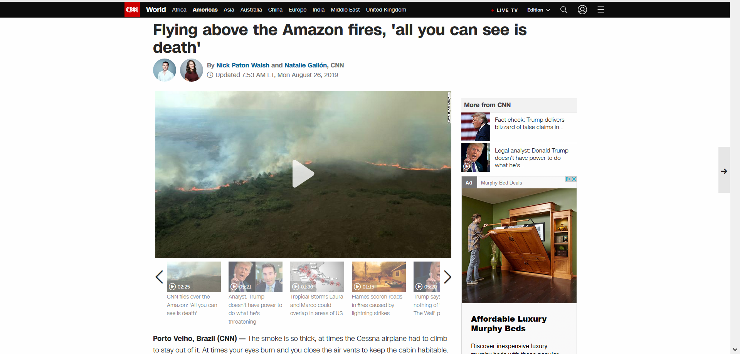
https://www.cnn.com/2019/08/25/americas/amazon-fire-efforts-damage/index.html

Slide 34
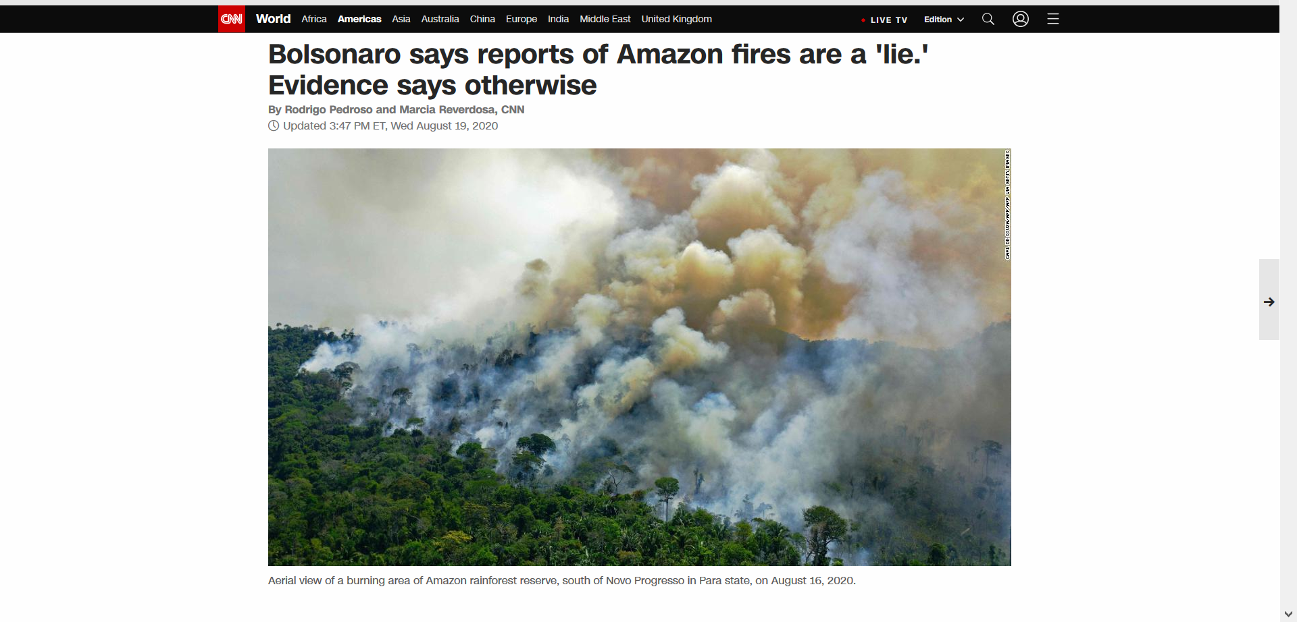
August 2020 https://www.cnn.com/2020/08/19/americas/brazil-amazon-fires-bolsonaro-intl/index.html

Slide 35
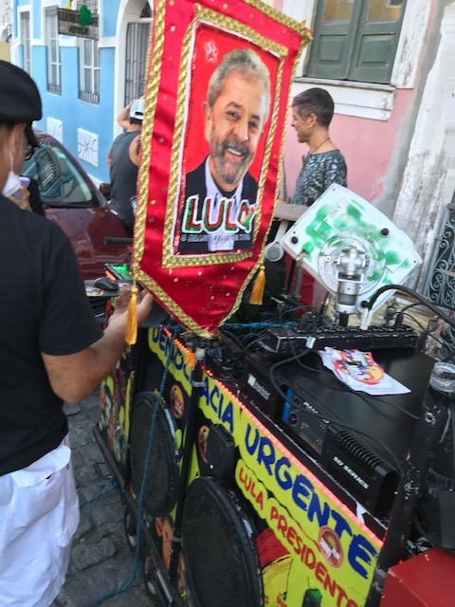
Presidential runoff between Bolsonaro and Lula will influence the fate of the Amazon.

Slide 36
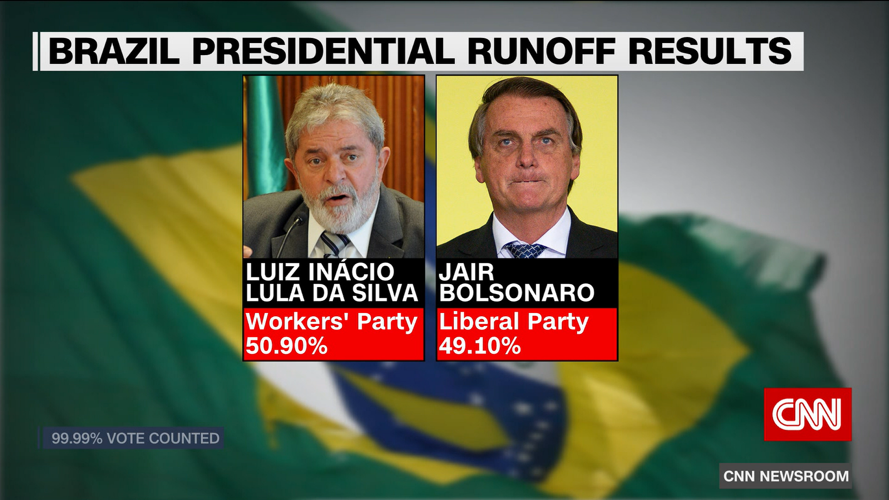
Look at this margin of Lula’s victory!

Slide 37
https://www.cnn.com/2022/10/30/americas/brazil-election-lula-da-silva-wins-intl/index.html
Lula da Silva called for “a new world governance” to address climate change and stressed that Brazil should take a central role in that governance, given its natural resources. According to the head of Lula da Silva’s government plan, Aloizio Mercadante, another tactic will be to create a group including Brazil, Indonesia and Congo ahead of the UN-led November 2022 Conference of Parties. The group would aim to pressure richer countries to finance the protection of forests as well as outlining strategies for the global carbon market.

Slide 38
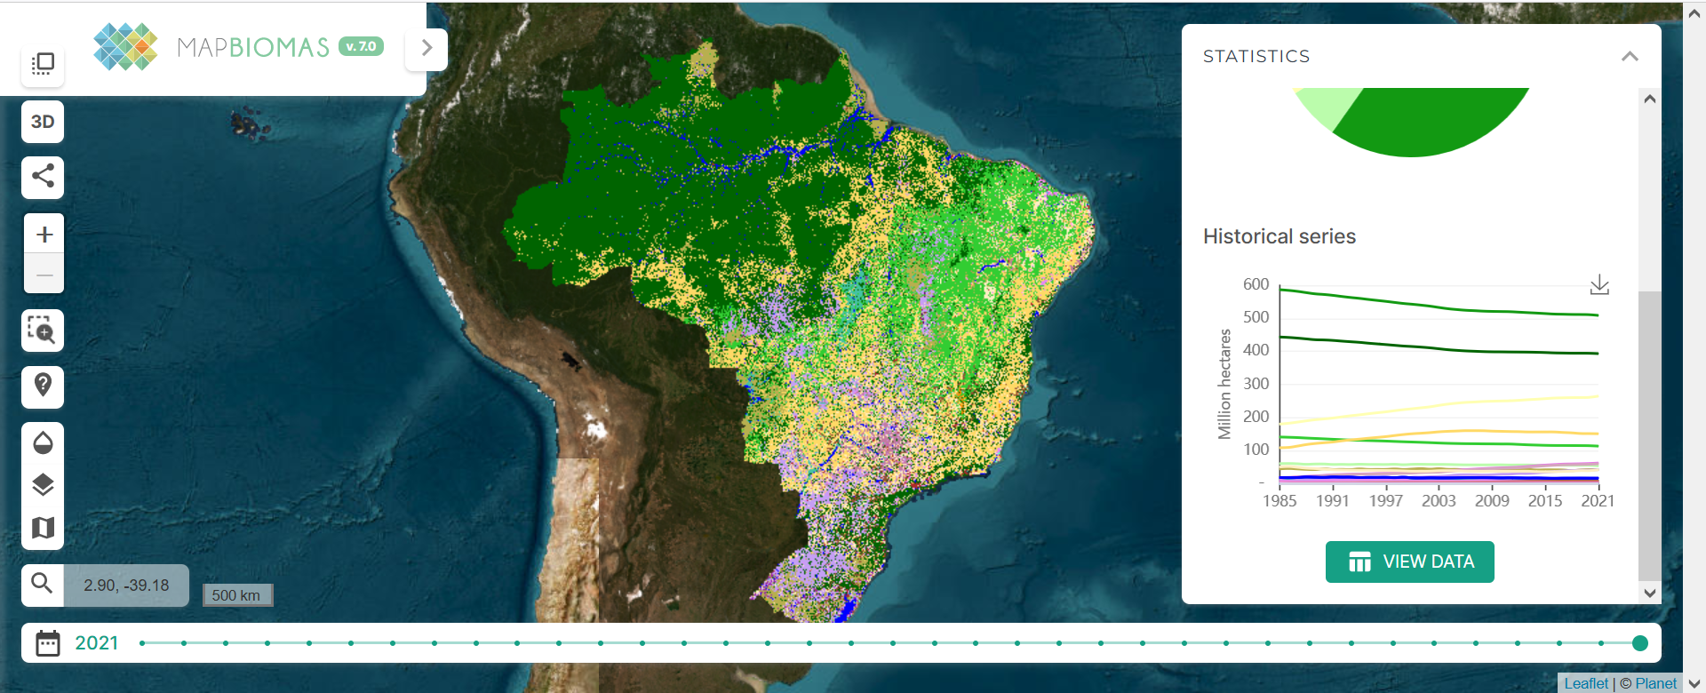
This is the first page of the MapBiomas data platform. https://mapbiomas.org/en?cama_set_language=en

Slide 39
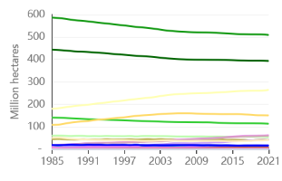
This shows each class’ size at each time point.
Forest
Agriculture
Pasture

Slide 40
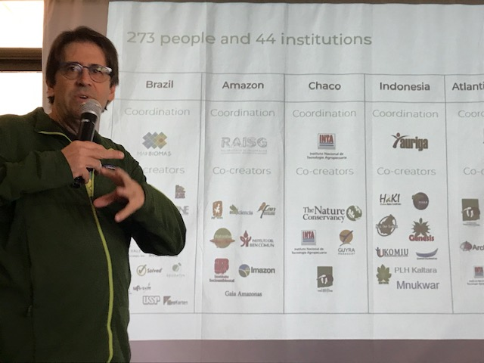
Tasso Azevedo is the driving force behind MapBiomas

Slide 41
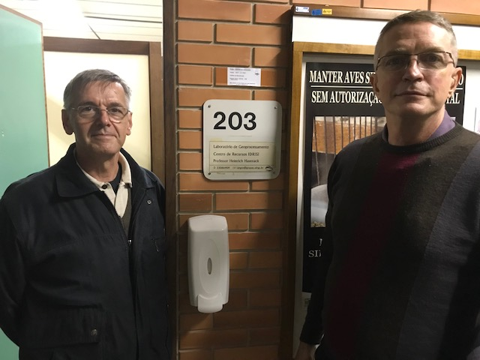
Professor Hasenack in front of the IDRISI Resource Center.

Slide 42
Should humans reduce tropical deforestation?
If not, then why not?
If so, then why and how?

Slide 43
Tropical Forests are a coupled human-natural system
How do humans influence tropical forests?
How do tropical forests influence humans?
Who wants to understand the possible future tropical forest scenarios?

Slide 44
Tropical Forests are a coupled human-natural system
How do humans influence tropical forests?
Humans cause deforestation, mostly for agriculture.
How do tropical forests influence humans?
Land change accounts for about 15-20 percent of greenhouse gas emissions, mostly due to tropical deforestation and forest degradation. Tropical deforestation increases the likelihood of coronaviruses jumping from animals to humans. Tropical forests are a source of minerals for your iPhones and electric cars.
Who wants to understand the possible future tropical forest scenarios?
Scientists who study climate change, biodiversity, viruses, agriculture, genocide, etc.
Clark Professors Sangermano, Estes, Williams, Rogan, Pontius, and Eastman.
Professionals at Conservation International, MapBiomas, and Verra.

Slide 45
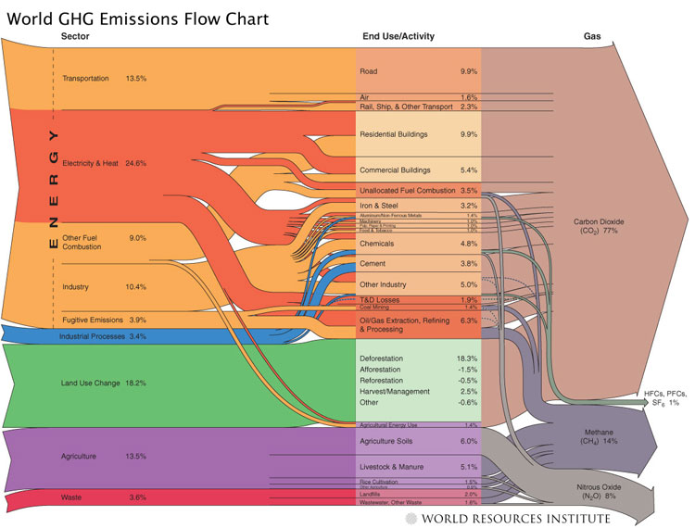
Land use change accounts for 15-20% of emissions
Transportation 13.5%
Energy & Heat 24.6%
Carbon Dioxide (CO₂) 77%
Other Fuel Combustion 9.0%
Industry 10.4%
Fugitive Emissions 3.9%
Industrial Processes 3.4%
Land Use Change 18.2%
HFCs, PFCs, SF₆ 1%
Methane (CH₄₎ 14%
Agriculture 13.5%
Waste 3.6%
Nitrous Oxide (N₂O) 8%
Notes:
Solution requires addressing all emissions areas, but CI comparative advantage is forest conservation, and also some energy policy.
Background:
Global program of biological sequestration – one-third of a trillion tons of CO2 could be sequestered (absorbed and stored) by 2050 by restoring degraded and fragmented natural ecosystems, by protecting threatened wilderness areas and intact natural ecosystems from being destroyed, and adopting best practices in the agriculture and forest products sectors. These are vital and necessary actions to help achieve atmospheric stabilization of low GHG concentration targets (≤450 ppm) consistent with minimizing impacts on biodiversity. Having standing forests, grasslands, mangroves, peat lands and wetlands eligible for carbon trading also opens up literally tens of billions of dollars for conservation in countries where CI works. If not strictly mission-critical, forest sequestration is at least so important to CI’s mission that it deserves to be ranked as a near equal to mission-critical outcomes.

Slide 46
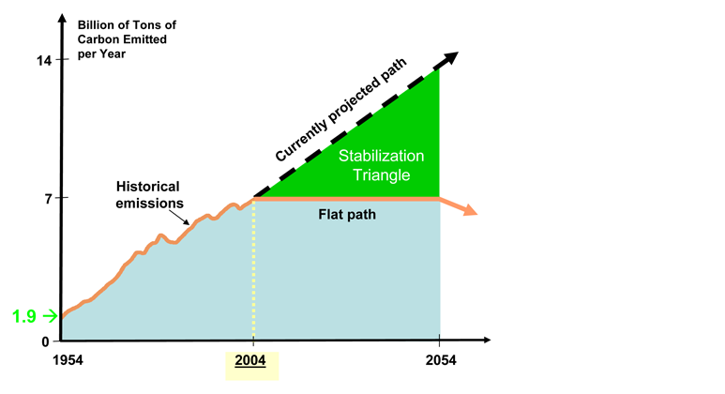
How much can forest carbon projects help mitigate climate change and reach stabilization goals?
Goal is to prevent accumulated emissions from trajectory by 400 billion tC by 2050.
100 billion tons could come from land-based carbon offsets.
Notes:
(

Slide 47
Discussion Questions
Who caused climate change, how, and why?
Should the role of wealthy industrialized countries differ from the role of other countries in reducing greenhouse gas emissions?
Why are tropical countries destroying their forests?
What would be a sufficient incentive for tropical countries to reduce deforestation?
Who should pay for the incentive?
Do those who should pay have the necessary resources and incentives to pay?
How can we motivate those people to pay?
Who should get paid to change their behaviors?
The people who stop deforestation will do what instead?
The project proposers will do what with a carbon credit?
Who should be responsible that the system works in a legitimate effective way?

